Slide 1
The Leadership of Yenisei Kyrgyz in Eurasia
Cholpon CHOTAEVA
Anthropology, AUCA

Slide 2
Contents
Ancient Kyrgyz State
Yenisei Kyrgyz State
Great Kyrgyz Empire
Ethnogenesis of Kyrgyz people
Conclusion

Slide 3
Ancient Kyrgyz State
(III BC-V AD)
201 BC – first record of ethnonym Kyrgyz (Gegun in Chinese) in Shi-ji (Historical records) of Sima Tan
Later in the north they subdued possessions of Hunyuy, Kyueshe, Dinlin, Gegun and Tsayli, therefore elders and nobles obeyed Mode Shenuy and recognized him as wise.

Slide 4
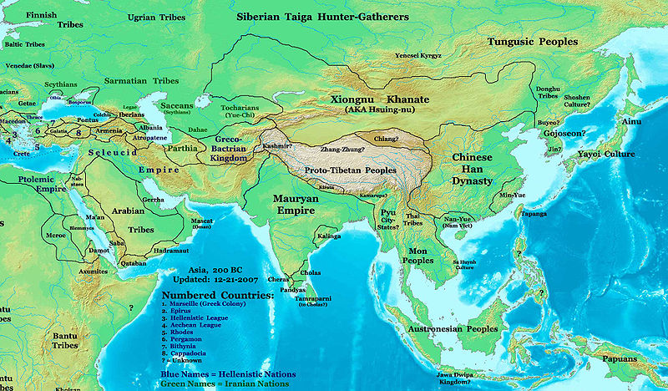
Hunnu Empire in II BC

Slide 5
Ancient Kyrgyz State
(III BC-V AD)
I BC – record of location of ancient Kyrgyz state in Han-shu (History of Han) of Ban Gu: in Eastern Turkestan

Slide 6
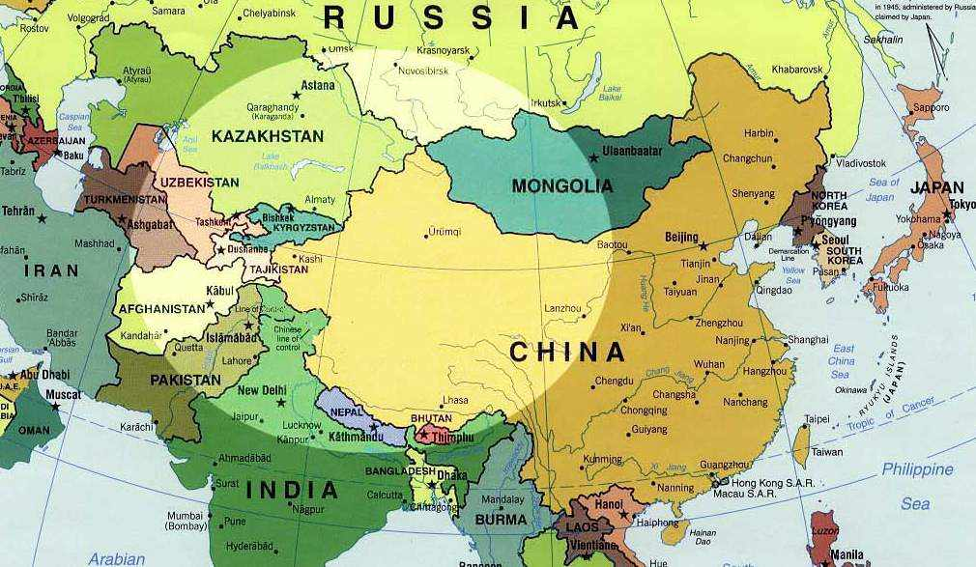
Location of ancient Kyrgyz state

Slide 7
Ancient Kyrgyz State
I BC – Kyrgyz were recruited as soldiers of Hunnu and conquered Dinling in the Yenisei River
I BC – Hunnu defeated Chinese and imposed the Chinese general Li Lin as the ruler of Kyrgyz

Slide 8
Yenisei Kyrgyz (VII-XIII)
Sources: Greek, Arab, Persian, Sogdian, Turkic, Uighur (from VII)
Origin: Mongoloid, Turkic speakers
Territory: the Middle Yenisei River
Ruler: Barsbek (Ajo)
Army: 30000-100000 soldiers

Slide 9
International Relations
709 – anti-Turkic coalition of Yenisei Kyrgyz, Turgesh and Chinese
710 – the battle of Kyrgyz and Turks. Yenisei Kyrgyz were defeated by Turks and did not participate in wars for 40 years

Slide 10
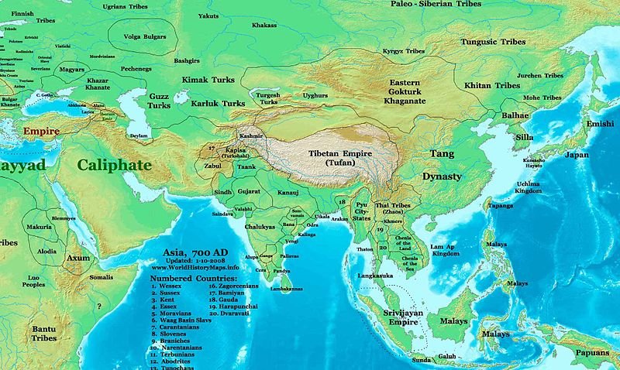

Slide 11
Internatonal Relations
758 – Uighurs subordinated Yenisei Kyrgyz
820-40 – War between Kyrgyz and Uighurs
840 – Kyrgyz defeated Uighurs and destroyed Ordu Balyk, the Uighur capital
XIII c – Kyrgyz state was destroyed by Mongols

Slide 12
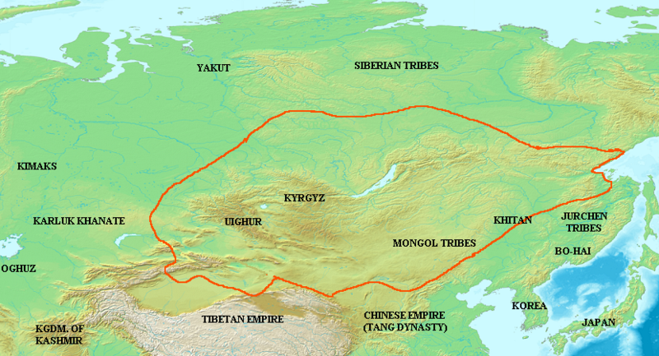

Slide 13
Great Kyrgyz Empire (IX-X)
Kyrgyz Great Power (Kyrgyzskoe Velikoderzhavie) – term first used by Barthold
Territory: from the Irtysh River (west) to Baikal Lake (east), from the Angara River (north) to the Gobi Desert (south)
X c – state disintegrated into smaller kingdoms: Yenisei, Altai

Slide 14
State structure
Ajo (kagan) – ruler
Buiruk - advisor
Boila (judge making decisions) and Yargan (judge putting them into effect)
Tutuks - rulers of regions
Tarkans - military rulers in regions
Biys - rulers of clans
Tyutyuns - rulers of groups of families

Slide 15
Economy
Pastoralism (horses, camels, cows, sheep)
Agriculture (wheat, millet, oats)
Metallurgy (daggers, hatchets, spears, arrow, harness)
Hunting
Fishing
Trade (Kyrgyz Way of the Great Silk Road, musk, mammoth tusk, furs, wood)

Slide 16
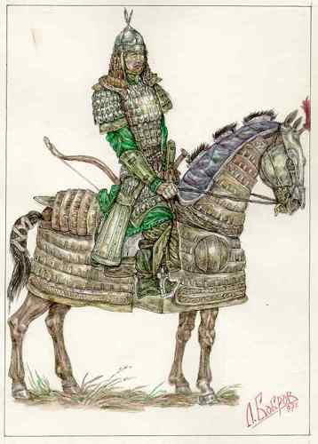
Army
Kyrgyz soldier
of IX century
100,000 soldiers

Slide 17
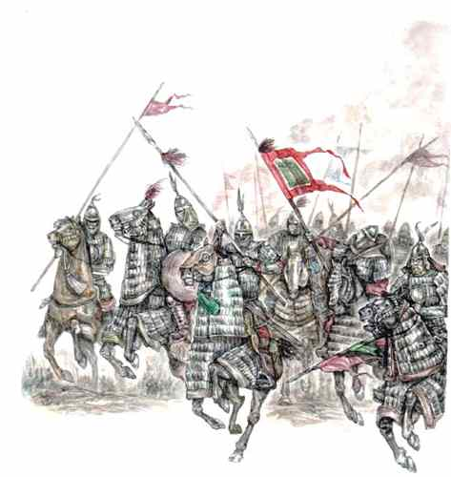
Перед атакой воины выстраивались длинными шеренгами "стремя к стремени". Разгон начинали медленно пуская лошадей шагом, затем переходили на рысь, и только в нескольких десятках метров от противника бросали жеребцов в галоп.
...Удар тяжелой конницы был страшен. Облаченные в пластинчатую броню воины, на свежих закованных в железо конях сминали на своем пути любую преграду...

Slide 18
Culture
Religion: Shamanism (Tengri and Umai)
Funeral rite: cremation
Society: patriarchal
Written language: Runic script
(used to 13 century)

Slide 19
Ethnogenesis of Kyrgyz people (XV-XVI)
Ethnogenesis – the history of ethnic group formation
Ethnic group is the group of people sharing ancestry myths, histories and cultures, a specific territory and a sense of solidarity (Anthony Smith)

Slide 20
Origin of ethnic term
Kyrk + kyz = 40 girls (a popular legend)
Kyrk + oguz = 40 oguzs (Baskakov)
Kyrk + yus = 40 hundreds (Radlov)
Kyrk + er = 40 men (Ahmed Togan)
Kara +gyz = black-haired people (Aitmuratov)
Kyrg + yz = red-haired people
Kyrylgys = unconquerable (Omurkulov)

Slide 21
Hypotheses on origin of Kyrgyz
Kyrgyz migrated from the Yenisei to Tienshan (Miller, Bernshtam)
Kyrgyz formed on basis of local tribes of Tienshan (Valikhanov, Bichurin, Aristov)
Kyrgyz is the result of both: the local tribes and migrated (Yenisei Kyrgyz)

Slide 22
Stages of migration
Hunnu military campaigns (I BC-I AD)
Turkic military campaigns (V-VIII)
Kyrgyz Great Empire (IX-X)
Mongol invasion (XIII)
Russian colonization of Siberia (XVIII)

Slide 23
Political organization
Tribal confederation of the right (on kanat) and the left (sol kanat) wings with the middle (ichkilik) group
Right wing (north): sarybagysh, bugu, sayak, solto, jediger, tynynseit, mongoldor, bagysh, baaryn, basyz, cherik, joru, boru, bargy, karabagysh
Left wing (Talas): kushchu, saru, munduz, jetagen, kytai, chonbagysh, basyg, toboi
Middle (south): kypchak, naiman, teyit, kesek, jookesek, kagdy, boston, noigut, doolos, avat

Slide 24
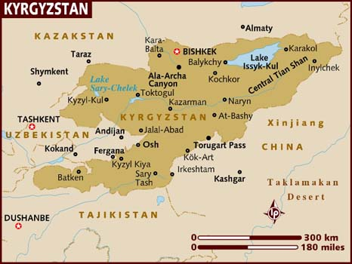
Location of Kyrgyz tribes

Slide 25
Ideological factors
Manas epic
Islam

Slide 26
Conclusion
Kyrgyz statehood (Yenisei, Kyrgyz empire) laid the foundation for the modern Kyrgyz ethnic group
Kyrgyz statehood laid the foundation for the modern Kyrgyz state

Slide 27
Readings
Tonyukuk inscription

